Slide 1
Constipation in Children: A Global Health Problem
Shaman Rajindrajith (MD, PhD, FRCPCH)
Professor of Paediatrics
University of Kelaniya
Sri Lanka

Slide 2

Constipation is a major global
public health problem in children

Slide 3
Why?
Human race is preoccupied with bowel habits
High prevalence across the world
Staggering healthcare costs
Leads to a great deal of suffering
Poor Health Related Quality of Life

Slide 4
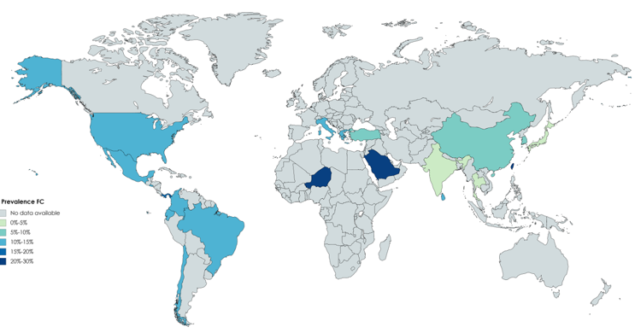
Global Map of Childhood Constipation
Global Pooled Prevalence 9.5%
Koppen I et al. Unpublished data

Slide 5
Epidemiology in Sri Lanka
Constipation was thought to be a disease of the developed countries.
First epidemiological survey in Gampaha district showed prevalence of 10.6% in school children (Rajindrajith et al. 2009)
An island-wide survey including 5 schools in 3 separate districts showed 15.4% of school children were suffering from constipation
(Rajindrajith et al. 2012)
Notes:
We conducted several epidemiological studies on functional gastrointestinal diseases in children. Our data show that constipation is a significant problem in the country. At least 10-15% of school children are suffering from constipation.

Slide 6
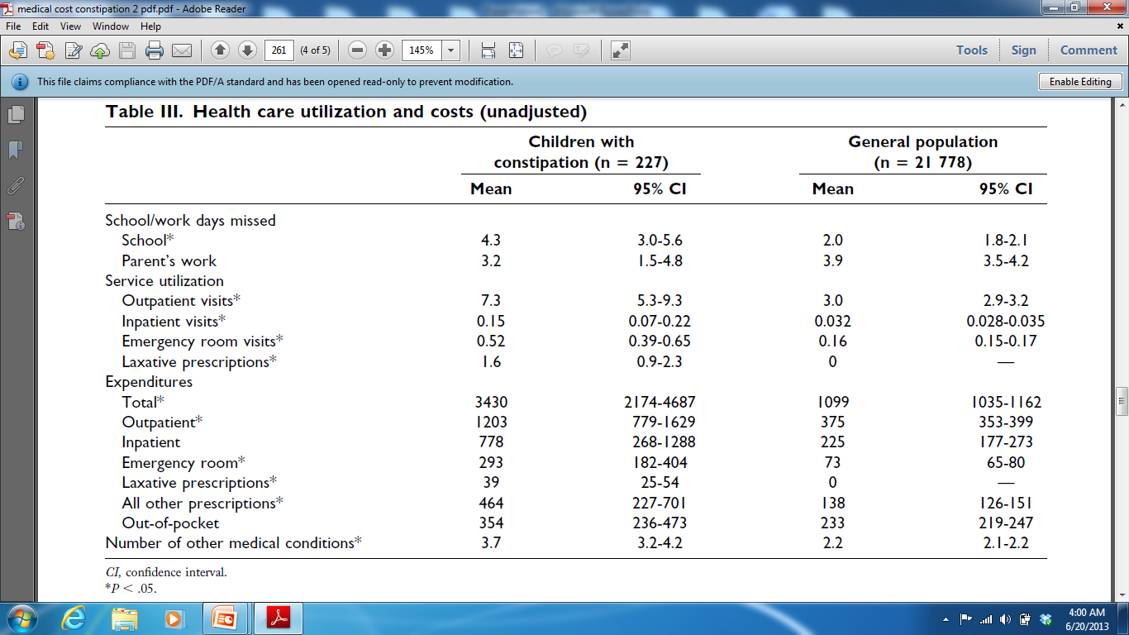
Healthcare Costs
Liem O et al. 2009

Slide 7
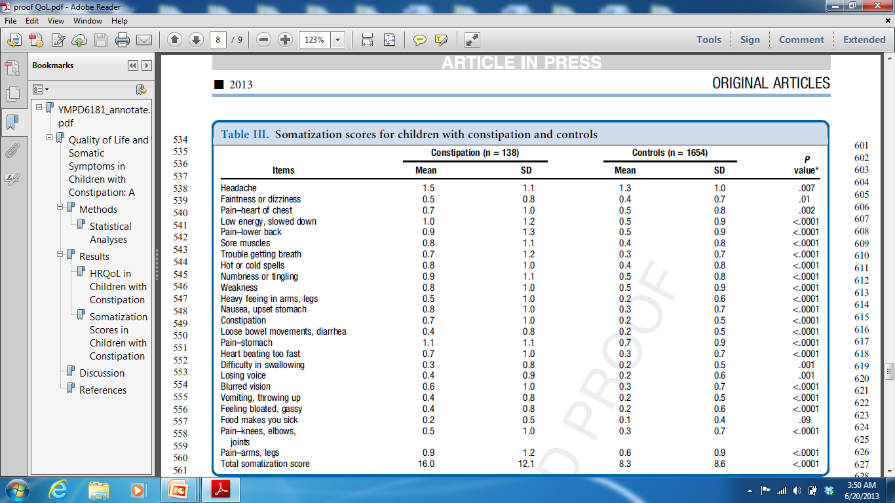
Somatic Symptoms
Rajindrajith et al. 2013

Slide 8
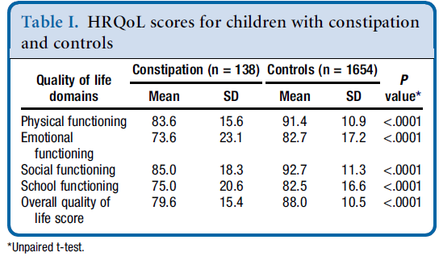
Health Related Quality of Life
Rajindrajith et al. 2013

Slide 9
What is childhood Constipation?

Slide 10

Hard Stools
Infrequent
motions
Rectal fecal mass

Slide 11
Rome IV criteria
Must have two or more of the following:
Defecation frequency <2 times per week
Faecal incontinence > once per week
Retentive posturing/stool retention
Painful or hard bowel motions
Large diameter stools
Faecal mass in the rectum
Criteria should be fulfilled at least once per week for 1 month
No organic diseases
(Hyams et al. 2016)

Slide 12
What Causes Constipation in Children?
Organic causes such as hypothyroidism, hypercalcaemia, caeliac diseases, are very rare among children with constipation
Tabbers et al NASPGHN/ESPGHN guideline 2014
Intestinal diseases like intestinal neuronal dysplasia, neurpathies and myopathies are extremely uncommon

Slide 13
Over 95% of children have functional constipation

Slide 14
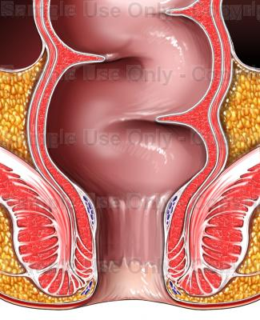
Pathophysiology

Slide 15

Risk Factors

Slide 16
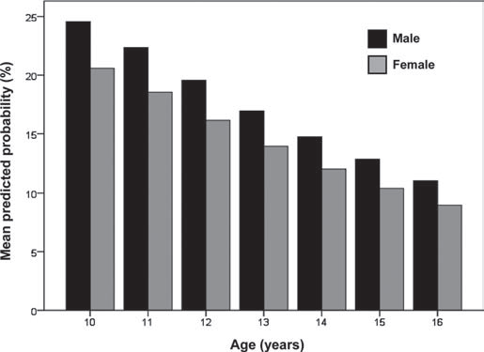
Effects of Age and Sex
Rajindrajith et al 2012

Slide 17

Dietary Fiber
Several studies have shown poor intake of fiber is a risk factor for constipation
Lee et al. 2007
Roma et al. 1999
Morais et al. 1999
(normal fiber intake is age in years+ 5 grams)

Slide 18

Junk Food
Tam et al. (2012) found consumption of fast food increase tendency to develop constipation in children
(OR = 1.14 95% CI 1.03-1.26)

Slide 19

PSYCHOLOGICAL STRESS

Slide 20

Association between constipation and exposure to stressful life events
Stressful event | Constipation (n=416) n (%) | Controls (n=2283) n (%) | OR (95% CI) | P value
Separation from best friend | 133 (32) | 519 (22.7) | 1.60 (1.26-2.02) | 0.00006
Failure in an exam | 82 (19.7) | 244 (10.7) | 2.05 (1.54-.43) | <0.00001
Severe illness in family | 106 (25.5) | 281 (12.3) | 2.44 (1.88-3.16) | <0.00001
Parental job loss | 30 (7.2) | 62 (2.7) | 2.78 (1.73-4.46) | <0.00001
Frequent punishment at home | 65 (15.6) | 140 (6.1) | 2.83 (2.04-3.95) | <0.00001
Living in war affected area | 195 (46.8) | 883(38.7) | 1.40 (1.13-1.74) | 0.002
Major psychological trauma leads to constipation
- Inan M, et al. 2007, Benninga M, et al. 1994
No association with divorce of parents
- Inan M, et al. 2007, Lisboa VA, et al. 2008

Slide 21

Child Maltreatment and Constipation
Type of abuse | Constipation No (%) | Controls No (%) | p value
Physical | 57 (41.6) | 381 (23.1) | <0.0001
Emotional | 56 (40.9) | 340 (20.8) | <0.0001
Sexual | 8 (5.8) | 43 (2.6) | 0.03
Rajindrajith et al. 2014

Slide 22
Clinical evaluation of children with constipation

Slide 23
Presenting features of chronic constipation
Reduce frequency of defecation
Pain while passing stools
Faecal incontinence
Stool withholding
Occasional large volume stools
Straining
Bleeding PR
Abdominal pain and distension
Urinary incontinence

Slide 24
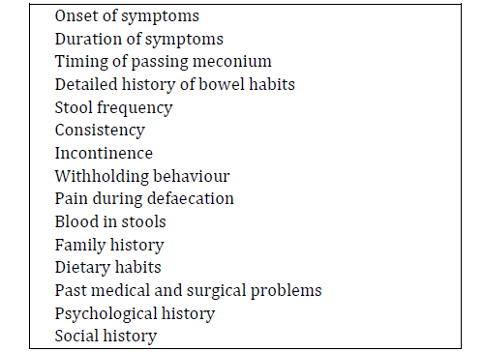
Main components of the clinical history

Slide 25
Main clinical features in physical examination
Growth parameters
Dysmorphic features
Abdominal examination
Distension
Scares
Faecal masses
Perianal and per rectal examination
Lower limb neurology

Slide 26
Red flag features of constipation
Delayed passage of meconium
Bilious vomiting
Bloody diarrhoea
Failure to thrive
Developmental delay
Abdominal distension
Ectopic anus
Perianal fistulae
Features of spinal bifida
Asymmetric growth of lower limbs
Loss of perianal sensation
Abnormal lower limb neurology

Slide 27
Management of children with constipation

Slide 28
Constipation is a clinical diagnosis

Slide 29
Following investigations has no place in day-to-day management
Plain abdominal X-ray
Thyroid function tests
Cows milk allergy
Coeliac screening
Testing for hypercalcaemia

Slide 30
Plain abdominal X-ray
Use to assess faecal loading in the colon
Three methods are described in literature
Barr et al. 1979
Blethyn et al. 1995
Leech et al. 1999
A systematic review showed poor correlation with clinical findings. (Reuchlin-Vroklage et al. 2005)
Scoring systems have poor inter and intra-observer reliability (de Lorijn et al.2006)

Slide 31
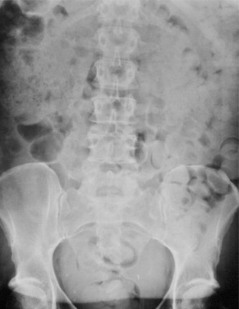
Notes:
Plain abdominal X ray is a commonly ordered investigation in children with constipation.

Slide 32
Testing for Hypothyroidism
A study by Bennett et al. JPGN 2012
873 thyroid function tests
56 had evidence of hypothyroidism
9 had clinically significant hypothyroidism and constipation
1 had constipation as the presenting feature
The majority of hypothyroid patients have normal bowel habits
(Muller-Lissner et al 2005 Am J Gastroenterol)
Notes:
I would like to put an emphasis on this slide. Most among us tend to order TFT in children and adults with constipation like a knee jerk reaction thinking they have hypothyroidism. I think time has come to review this practice with current evidence. It is rare at least for children with hypothyroidism to present with isolated constipation. They often have other features of the disease in the clinical history and physical examination. This paper from the US shows lack of utility of TFT in children with constipation. In addition the other paper from Germany shows the majority of patients with hypothyroidism had normal bowel habits.

Slide 33
Colonic transit studies
The transit time of the colon is studied using
radio-opaque markers
radioneuclear scintigraphy
Wireless motility capsule
Total and segmental transit times are calculated and help in the diagnosis of slow transit constipation
Total transit time >100 hours is suggestive of severe constipation
De Lorijn, et al. 2004
Several studies have shown delayed CTT in children with constipation
de Lorijn F, et al. 2004

Slide 34
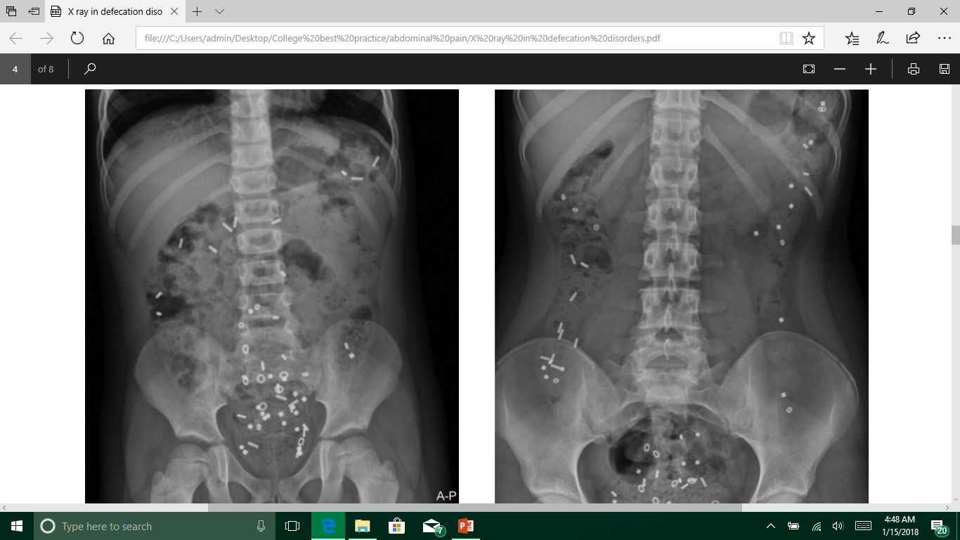
Colonic Transit Studies
Rectosigmoid Retention
Slow Transit Constipation

Slide 35
Other radiological tests
Ultrasonography
Defecography
Contrast enemas
MRI of spine

Slide 36


Slide 37
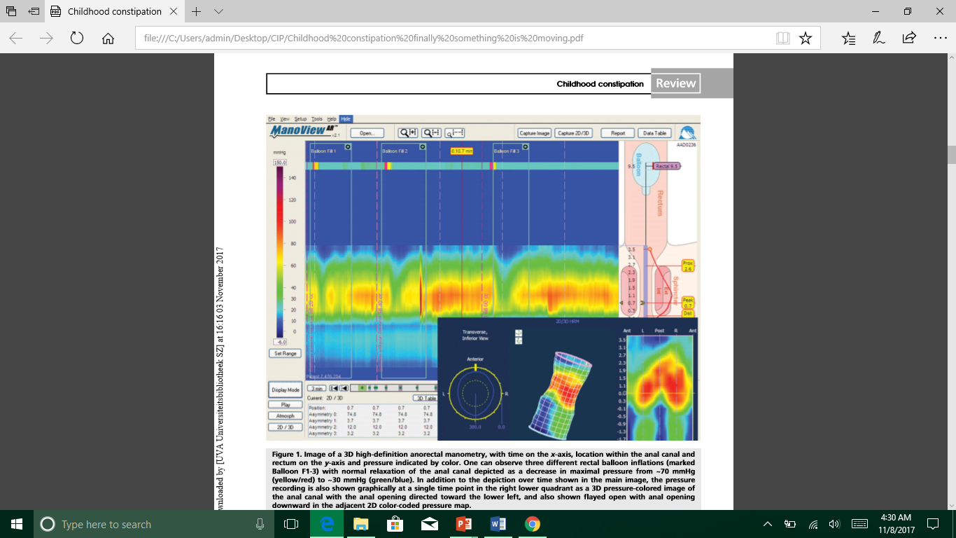
High definition anorectal manometry
Provide information on
Sphincter function - Continence
Rectal sensation - Rectal compliance
Anorectal reflexes
Studies are still limited but emerging in children with constipation. Koppen et al. 2016

Slide 38
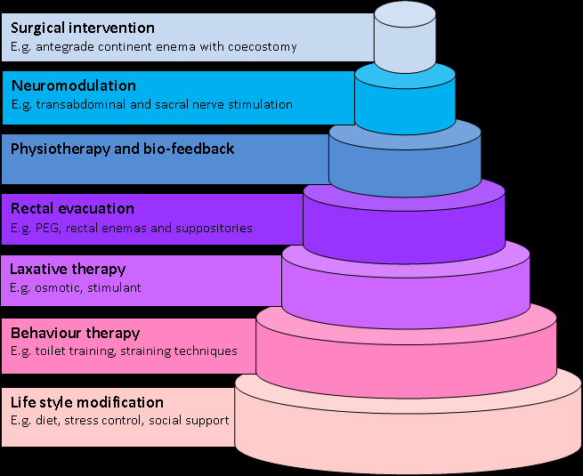
The new management paradigm

Slide 39

Life Style Modification
Build a safe environment to children.
Eliminate home and school related punishments
Teach coping mechanisms to children to deal with day to day stresses

Slide 40
Toilet training
Stool with-holding plays a crucial role in developing constipation.
Children should encourage to use the toilet after each meal (taking advantage of gastrocolic reflex)
The proper techniques of seating and straining need to be taught
A Cochrane review has shown beneficial effects of toilet training in the management
Brazzeli M, et al. 2011

Slide 41
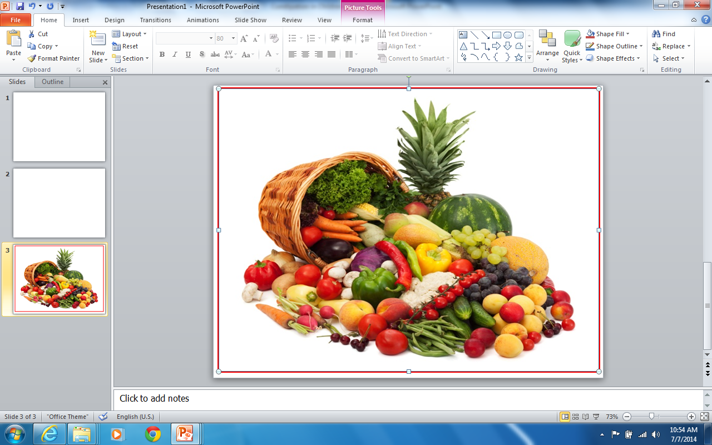
Story of fiber and water
Current evidence does not support to use fiber supplement in treating children with constipation
Tabbers MM, et al. 2014
Increase consumption of water has no place in clinical management
Jennings et al 2009
Increase the fiber/fluid if the child is not receiving normal daily requirement

Slide 42

Probiotics
Several trials in children have tried a variety of probiotics
Lactobacillus rhamnosus
Lactobacillus reuteir
Lactobacillus casei
Evidence is still not strong enough to use probiotics in the treatment of constipation in children
Tabbers et al 2015

Slide 43
Faecal disimpaction
Oral route
Polyethylene glycol
Effective in 75%
Less pain and discomfort
More effective clinically and economically
Rectal route
Only when oral route fail
Under sedation
Phosphate enema
Mineral oil
Bisacodyl suppositories

Slide 44
Maintenance therapy
Aim to keep stools soft to facilitate defecation
With single or multiple drugs
Osmotic laxative
Stimulant laxatives
Novel agents
Duration is variable
Close follow up
Slow withdrawal of drugs over months (3-6)
Closely follow up to prevent relapses

Slide 45
Laxatives in the maintenance phase
Osmotic laxative
Stimulant laxatives
Polyethylene glycol
Fist choice
Very effective than others
Lactulose
Safe, time tested drug
Less effective than PEG
Magnesium sulphate
Less effective than PEG
Side effects
Docusate sodium
Diphenylmethanes
Bisacodyl
Sodium picosulphate
Amthraquinones
Senna
Very effective when combined with osmotic laxatives as an ajuvant

Slide 46
Novel Therapies
Chloride secreting agents
Linaclotide and lubiprostone
One trial shows benefits for children
Prucalopride
Serotonine 4 receptor agonist
Very effective in adults
Paediatric study showed no beneficial effects
Probiotics
Evidence are still insufficient

Slide 47
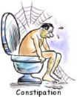
Laxatives : Confronting fears
Fear of habituation
Fear of tolerance
Fear of dependence
Fear of rebound

Slide 48
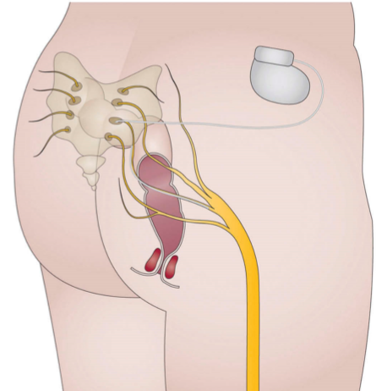
Sacral Nerve Stimulation
Stimulates the sacral nerves using an electrical system
Two small studies in children show promising results
Sulkowski et al 2015
van Wunnik 2015
Need further studies..

Slide 49
Surgical interventions
Injection of botulinum toxin
Antegrade continent enemas
Sigmoid resection
Colorectal resection
Subtotal colectomy
Proctocolectomy and ileoanal anastomosis

Slide 50
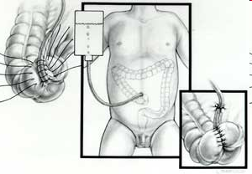

Slide 51
Take Home Messages
Constipation is a major public health problem
It significantly affects lives of children and their families
Risk factors are highly prevalent
Routine investigations do not help in day to day clinical management
Multifaceted approach is the best way in managing children with constipation

Slide 52










